Slide 1
Machine Learning
Cheque Amount Handwriting Recognition
Cairo University
Faculty of Computers and Information
By Mohamed Atta
Supervisor
Dr Aly Aly Fahmy
Dr Hanaa Baiomy Ali Mobarz

Slide 2
Motivation
The writing style of people vary and hence to confirm the number that is written on the check it is written in words too.Some numeric such as 1 and 7 may look same in many cases.This procedure will help to lessen confusion.
Another reason is to prevent fraudulent activities.Any person can add or change the digits for a higher amount if it is only written in digits.If it is written 600 $ on a check it is very easy to add one ‘0 ‘and can make it to 6000$.

Slide 3
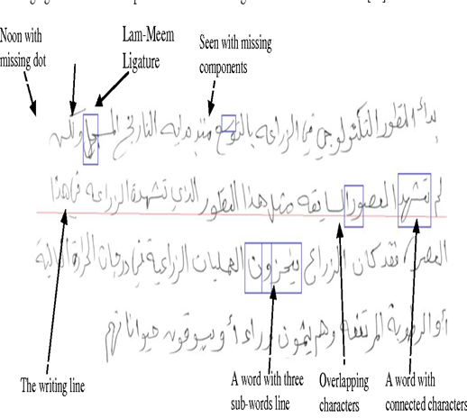
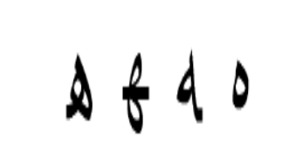
Arabic Language Challenges
Arabic texts still present difficult challenge:
1.Optical character recognition of printed texts has been a focus of research for the last few decades, Arabic printed text, being cursive, still poses a challenge.
2.The challenge is twofold: segmenting words into letters and identifying individual letters.
3.To recognize the text inside an image, the image is split into “pieces of Arabic words”, and each piece is scanned.
4.Even printed text is semi-cursive. Each word consist of one or more pieces (of an Arabic word).
5.The same letter may be written differently, depending on its location in the Word, as there are up to four different variations in form for each letter, Isolated, initial, medial and final.
6.Each word consist of one or more pieces (of an Arabic word).
7.Many Arabic letters are distinguished one from another only by diacritical Dots or strokes.

Slide 4
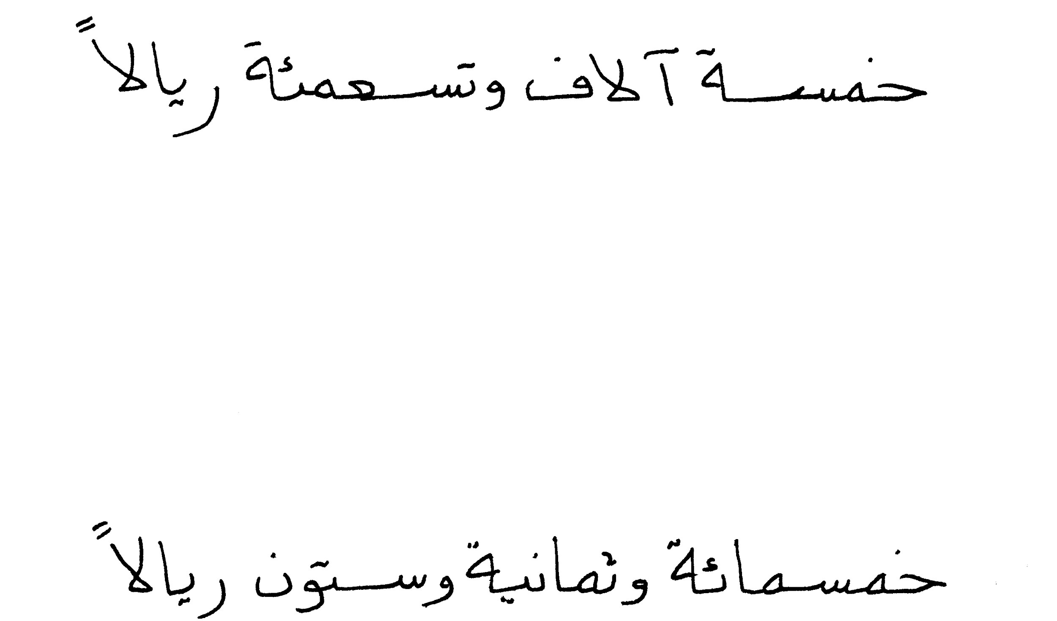
System Functionality
Input Image
Recognized Output
Processing
Trained Model , Words Level
خمسة ألاف وتسعمئة ريالا

Slide 5
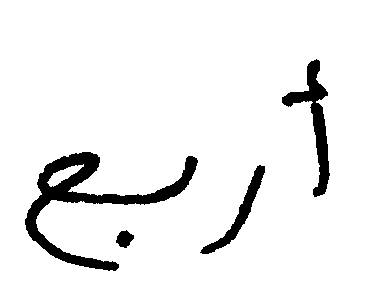
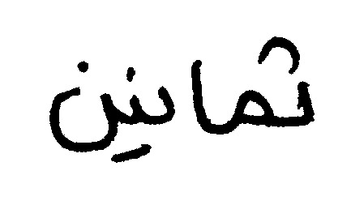

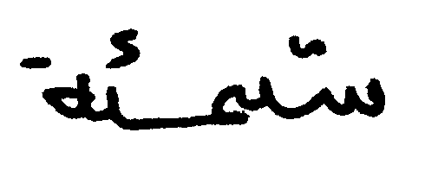
AHDB DataSet & Tools
This dataset has been collected in Qatar University and is essentially meant for Arabic Handwriting Recognition tasks.
The data set have most frequent Words Dataset and Cheque numbers DataSet
10K original training dataset
Keras with tensorflow , Augmentor

Slide 6
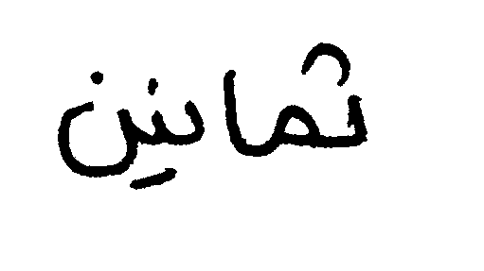

Preprocessing
Image Resize.
Image Cropping

Slide 7
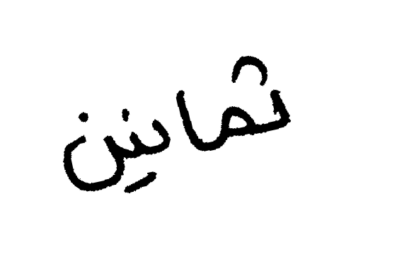
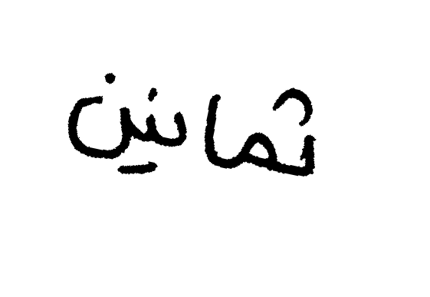
Data Augmentation
Original Image
Rotation

Slide 8
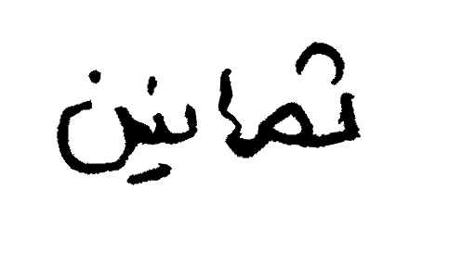
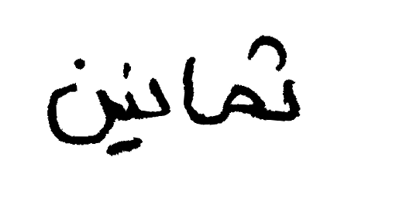
Data Augmentation
Augmentor Library easy tool for augmentation
Original Image
Distortion

Slide 9
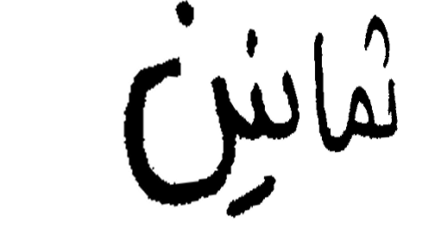

Data Augmentation
Original Image
Skewness

Slide 10
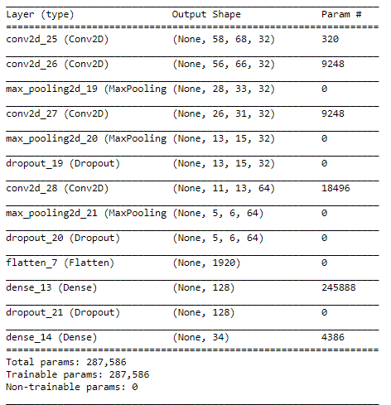
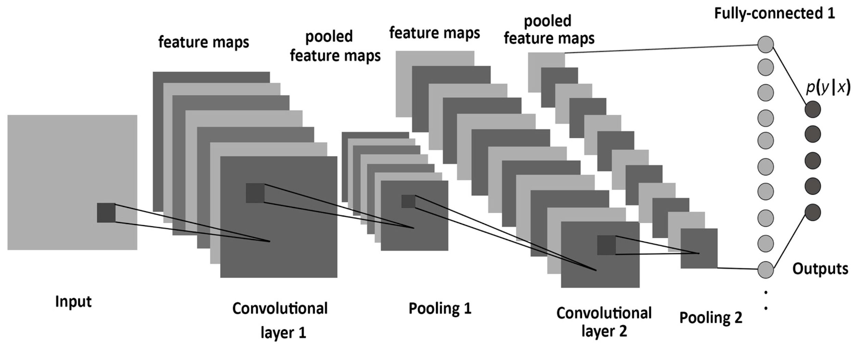
Classification Model
Detailed Model

Slide 11

Full sentence Processing
Splits the sentence based on Horizontal histogram projection of words to set of paws
Recognize the words according to sliding window of size 4.

Slide 12
Results
With Epochs = 200 the result
 | CNN Model | CNN Model With Dropout | CNN Model With Data Augmentation
Accuracy | 98 | 99,4 | 95 - 96,4

Slide 13

Thank You

